Slide 1
Transactions and Recovery:
ACID Properties

Slide 2

Objectives
Objective
Explain Transactions and Concurrency Control concepts

Slide 3
Introduction to Transactions

Slide 4
What are Transactions?
Concurrent execution of user programs is essential for good DBMS performance.

Slide 5

Transactions
A transaction is the DBMS’s abstract view of a user program: a sequence of reads and writes.
A user’s program may carry out many operations on the data retrieved, but the DBMS is only concerned about what data is read/written from/to the database.

Slide 6
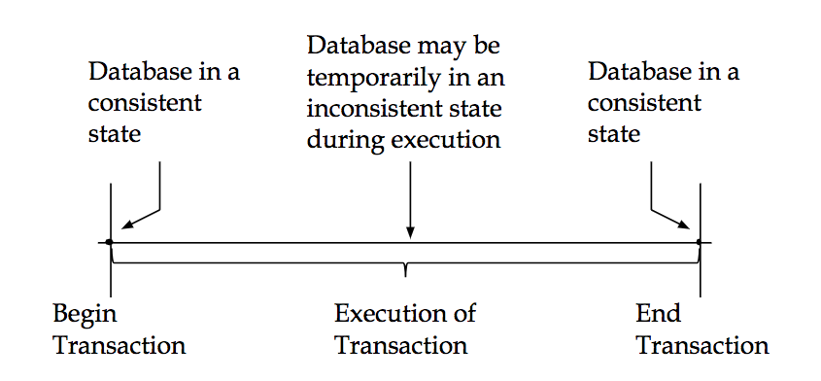
Transactions
Notes:
A transaction is a collection of actions that make consistent transformations of system states while preserving system consistency.

Slide 7
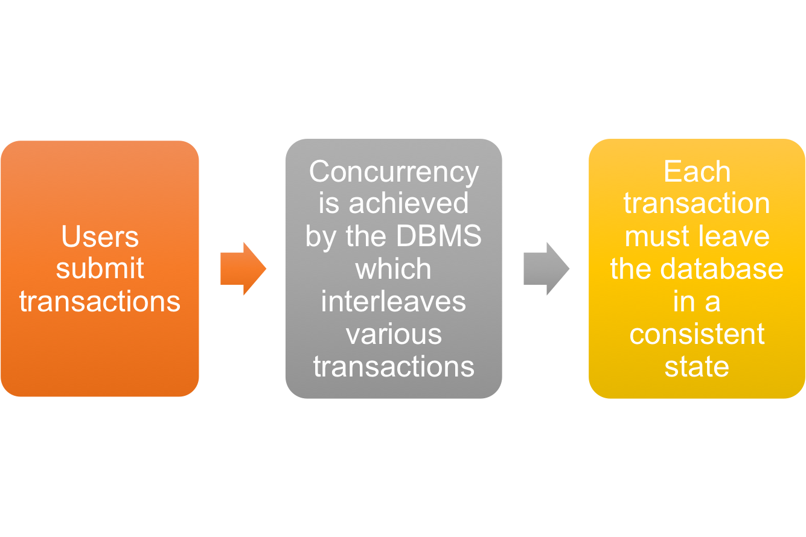
Concurrency in a DBMS
Potential Issues: Effect of interleaving transactions, and crashes.
Notes:
Users submit transactions, and can think of each transaction as executing by itself.
Concurrency is achieved by the DBMS, which interleaves actions (reads/writes of DB objects) of various transactions.
Each transaction must leave the database in a consistent state if the DB is consistent when the transaction begins.
DBMS will enforce some ICs, depending on the ICs declared in CREATE TABLE statements.
Beyond this, the DBMS does not really understand the semantics of the data. (e.g., it does not understand how the interest on a bank account is computed).
Issues: Effect of interleaving transactions, and crashes.

Slide 8
Principle of Transactions
ATOMICITY all or nothing
CONSISTENCY no violation of integrity constraints
ISOLATION concurrent changes invisible ⇒ serializable
DURABILITY committed updates persist

Slide 9
Principle of Transactions
ATOMICITY: all or nothing
A transaction might commit after completing all its actions, or it could abort after executing some actions.
Always executing all actions in one step, or not executing any actions at all.
DBMS logs all actions so that it can undo the actions of aborted transactions.

Slide 10
Principle of Transactions
CONSISTENCY : no violation of integrity constraints
Internal consistency
  A transaction which executes alone against a consistent database leaves it in a consistent state.
  Transactions do not violate database integrity constraints.
Transactions are correct programs

Slide 11
Principle of Transactions
ISOLATION: concurrent changes invisible ⇒ serializable
Serializability
  If several transactions are executed concurrently, the results must be the same as if they were executed serially in some order.
Incomplete results
  An incomplete transaction cannot reveal its results to other transactions before its commitment.

Slide 12
Principle of Transactions
DURABILITY: committed updates persist
Once a transaction commits, the system must guarantee that the results of its operations will never be lost, in spite of subsequent failures.
Database recovery

Slide 13
Example
T1:
BEGIN A=A+100, B=B-100 END
T2:
BEGIN A=1.06*A, B=1.06*B
Notes:
Intuitively, the first transaction is transferring $100 from B’s account to A’s account. The second is crediting both accounts with a 6% interest payment.
There is no guarantee that T1 will execute before T2 or vice-versa, if both are submitted together. However, the net effect must be equivalent to these two transactions running serially in some order.

Slide 14
Example
T1:
  Interleaving:
  T1: A=A+100, B=B-100
T2:
  Interleaving:
  T2: A=1.06*A, B=1.06*B
The DBMS’s view:
T1: R(A), W(A), R(B), W(B)
T2: R(A), W(A), R(B), W(B)
Notes:
Intuitively, the first transaction is transferring $100 from B’s account to A’s account. The second is crediting both accounts with a 6% interest payment.
There is no guarantee that T1 will execute before T2 or vice-versa, if both are submitted together. However, the net effect must be equivalent to these two transactions running serially in some order.

